Slide 1

Tableau interface
DATA ANALYTICS | IRONHACK

Slide 2

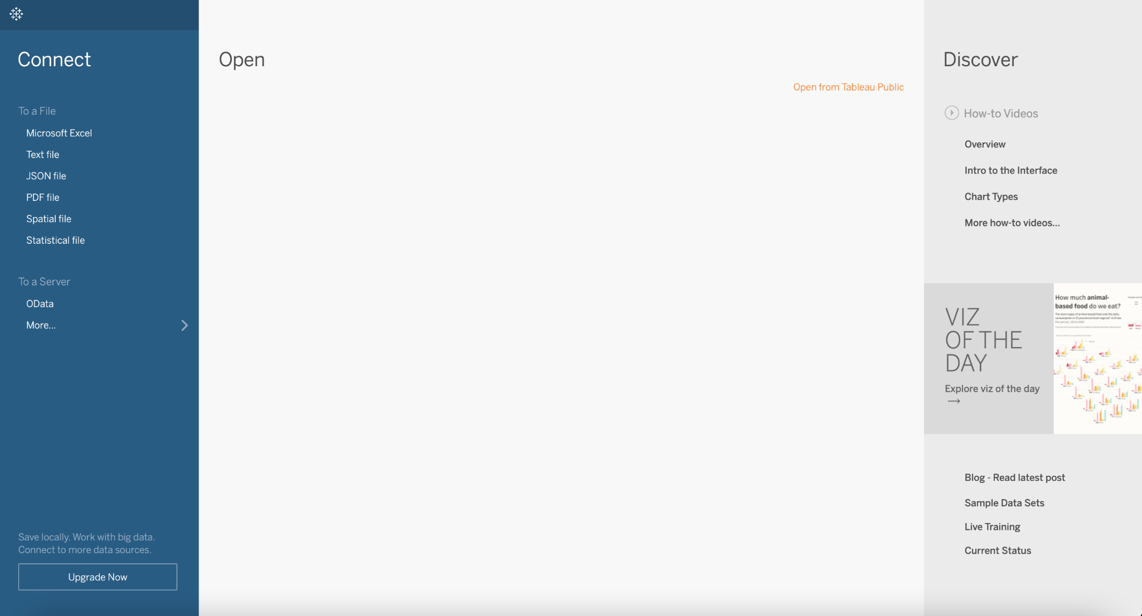
IRONHACK BOOTCAMP
MAIN PANEL

Slide 3
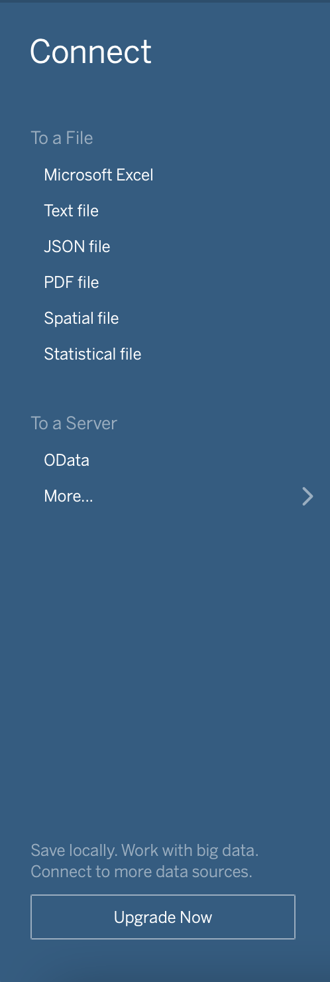
IRONHACK BOOTCAMP
IMPORTING FILES
To import files.

Slide 4
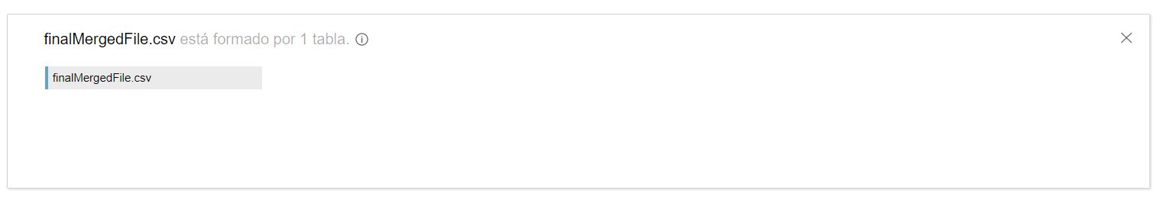
IRONHACK BOOTCAMP
LOADED FILES IN TABLEAU

Slide 5
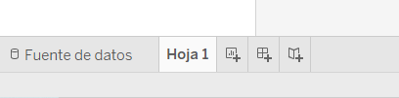
IRONHACK BOOTCAMP
SHEETS, DASHBOARDS AND STORIES

Slide 6
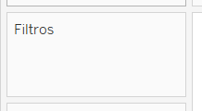
IRONHACK BOOTCAMP
FILTERS

Slide 7
IRONHACK BOOTCAMP
TABLEAU DATA TYPES

Slide 8
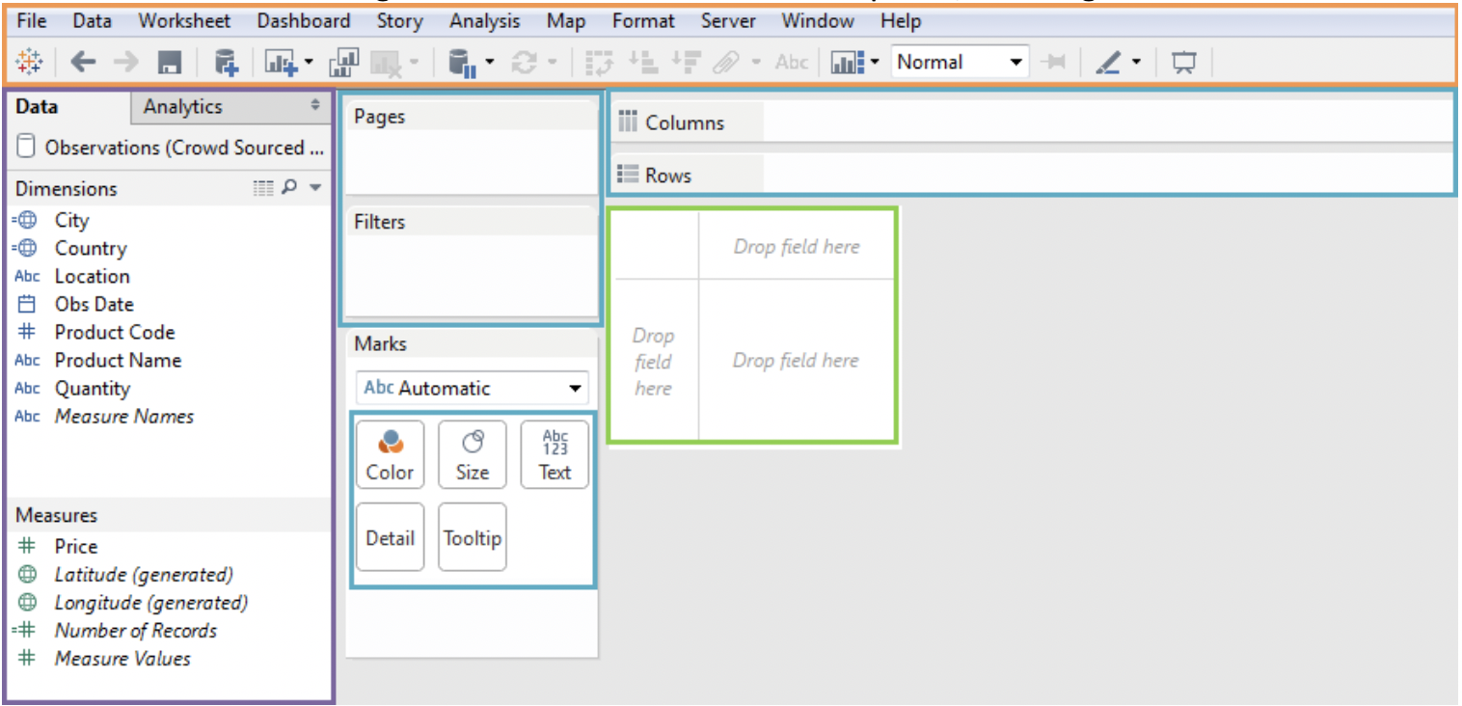
DATA WINDOW
Fields are split into:
Dimensions (splittable)
Measures (amount)
Geographicals

Slide 9
SHELVES
They allow you to control the display of a graph:

Slide 10
IRONHACK BOOTCAMP
CANVAS

Slide 11
TOOLBAR
It contains the columns to be displayed in the graph.

Slide 12
IRONHACK BOOTCAMP
DIMENSIONS
They are typically “categorical” columns that you can use to “split” the data.

Slide 13
IRONHACK BOOTCAMP
MEASURES
They are typically “numerical” columns. :
Numerical values
Averages
Counts
Sums….

Slide 14
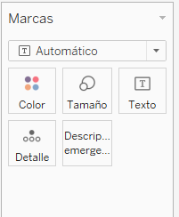
IRONHACK BOOTCAMP
MARKS
They allow you to control the display of a graph:
Color
Size
Text…
They also allow you to add additional features.

Slide 15
FILTERS
Drag and drop the variable you want to filter to the pane: “Filters”

Slide 16
NOTES
Right click on an empty espace on the canvas to add a note.

Slide 17
TITLES
Right click on the canvas name.

Slide 18
COLOR CODING TABS
Right click on the tab name and select the color

Slide 19
SHOW ME TAB
On the top right, you should see the “Show me” tab which allows you to
Select the type of visualization you want.
The dimensions and measurements that you have in the canvas determine the available plots.
It also tell you what you need in order to build the visualization:
Dimensions
Measurements

Slide 20
SCATTER PLOTS
Drag and drop the variable you want to be displayed on the ‘y’ axis in the
“Columns” toolbar.
Drag and drop the variable you want to be displayed on the ‘X’ axis in the
“Rows” toolbar.
Go to the menu and select Analysis and uncheck “Aggregate Measures”

Slide 21
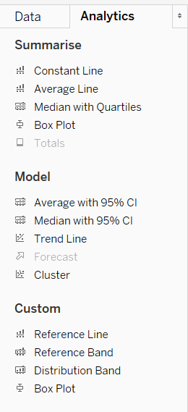
ANALYTICS TAB
On the “Data panel” there is another tab called “Analytics” which contains options to add trend lines.

Slide 22


